Slide 1

Predicting IMDb Ratings
Nathan Higley, Nancy Mathur, Robert McLauchlan

Slide 2
Data Collection

Slide 3
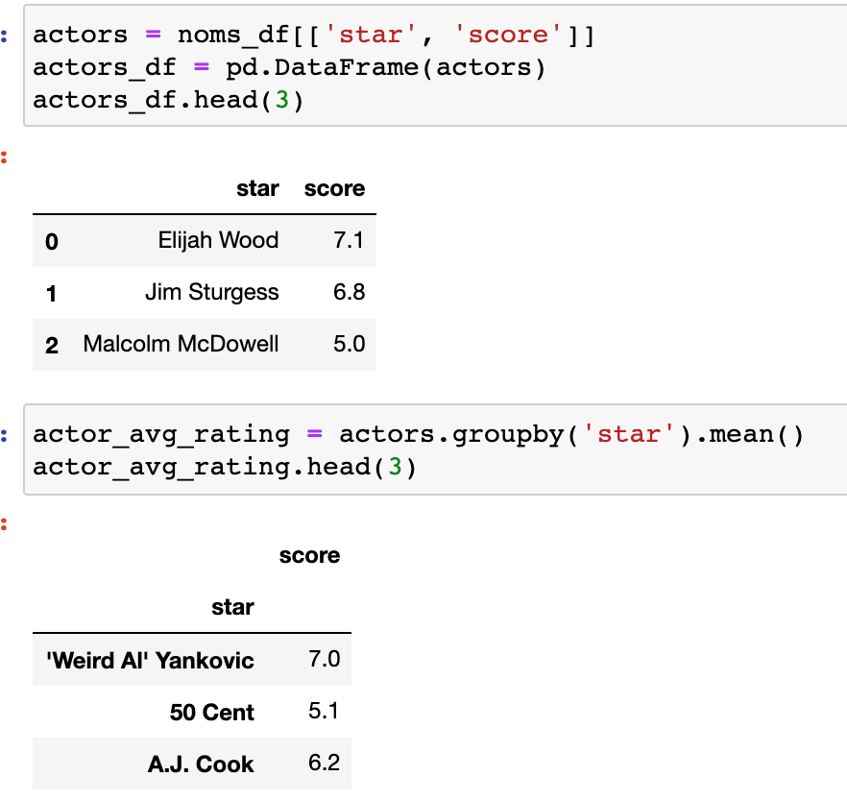

Merging Data

Slide 4
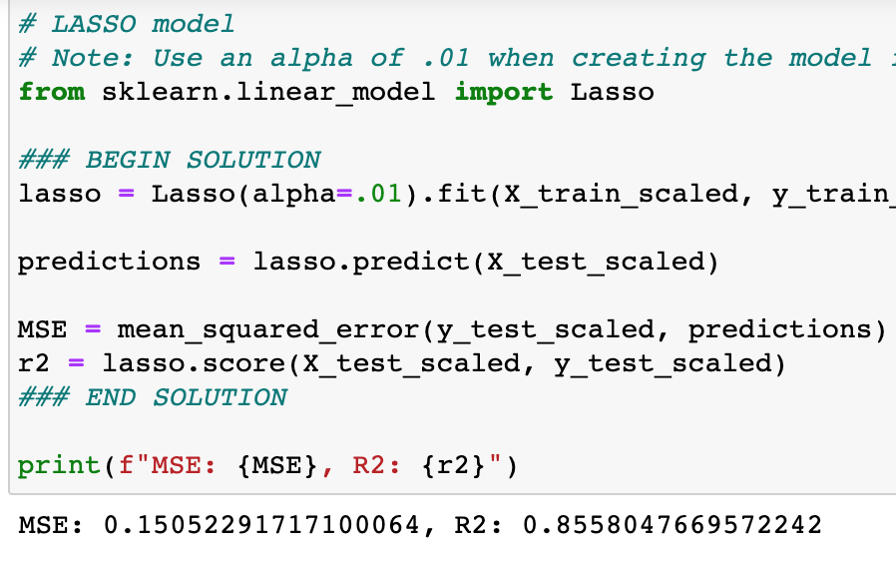
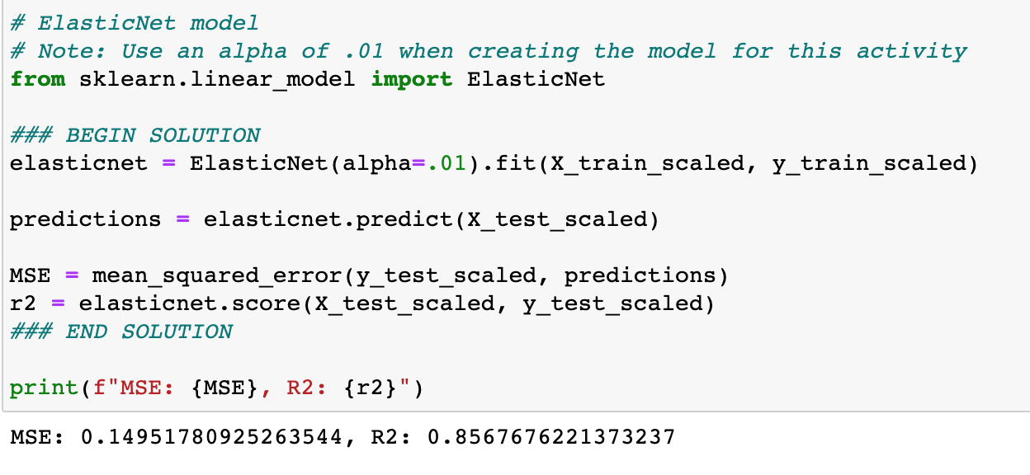
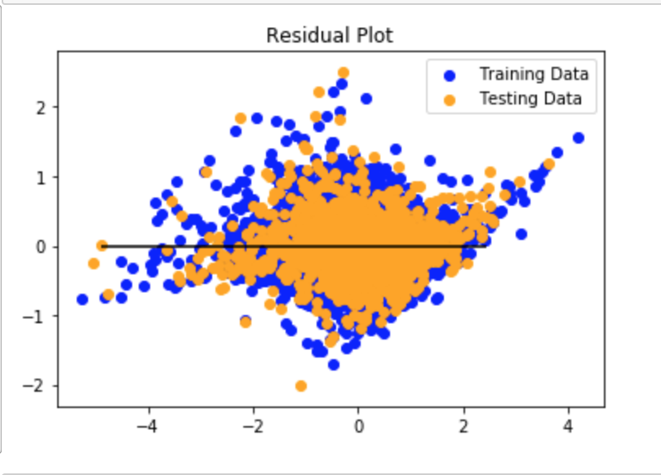
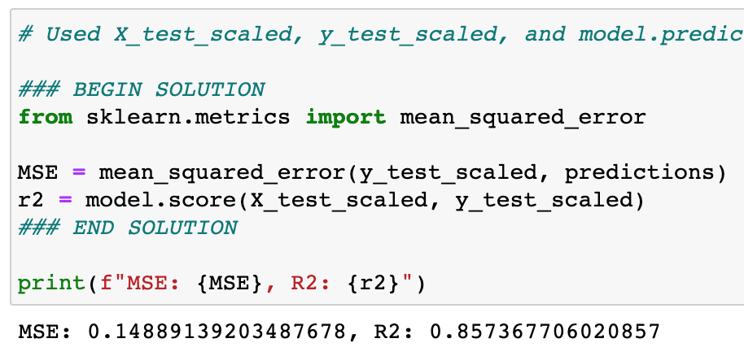
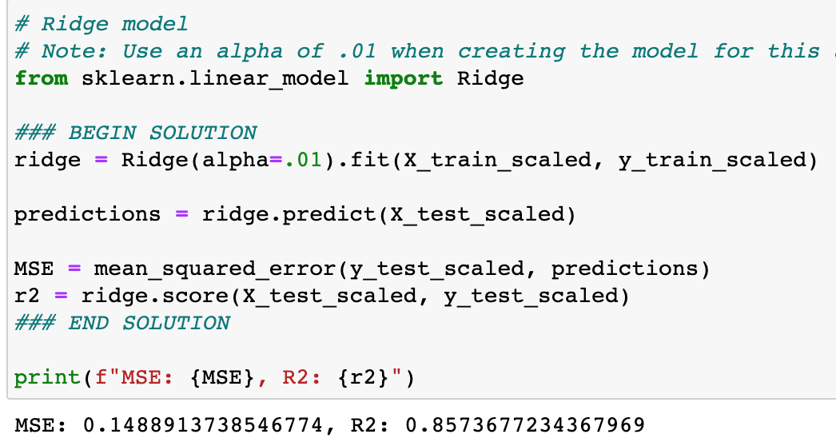
Linear Regression

Slide 5
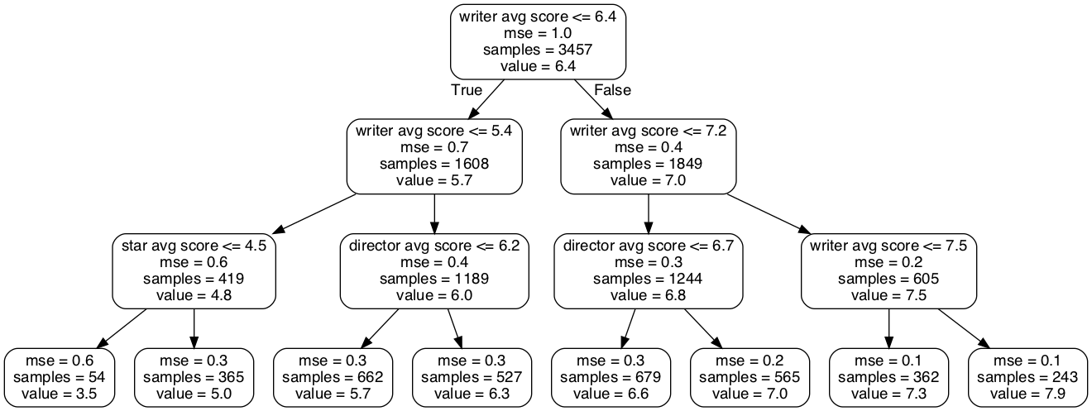
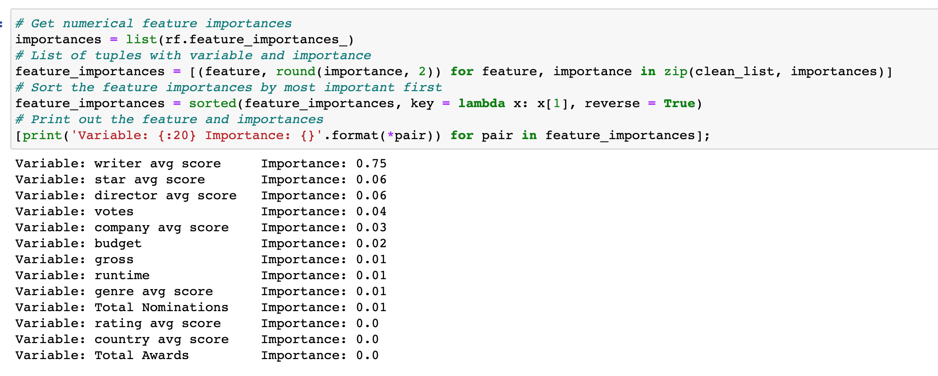
Random Forrest

Slide 6
Deep Learning Model

Slide 7
Tableu

Slide 8
Conclusion

